Slide 1
Quantum Computing Architectures (EE274) Lecture 8
Hiu-Yung Wong
feb. 18, 2025
hiuyung.wong@sjsu.edu, Office: ENG363
http://www.sjsu.edu/people/hiuyung.wong/index.html

Slide 2
Outline
Bloch’s Sphere and Expectation Values
Schroedinger Equation

Slide 3
Announcements
2/20 Thursday class will be recorded, no in-person class.
Please work on assignment 1.

Slide 4
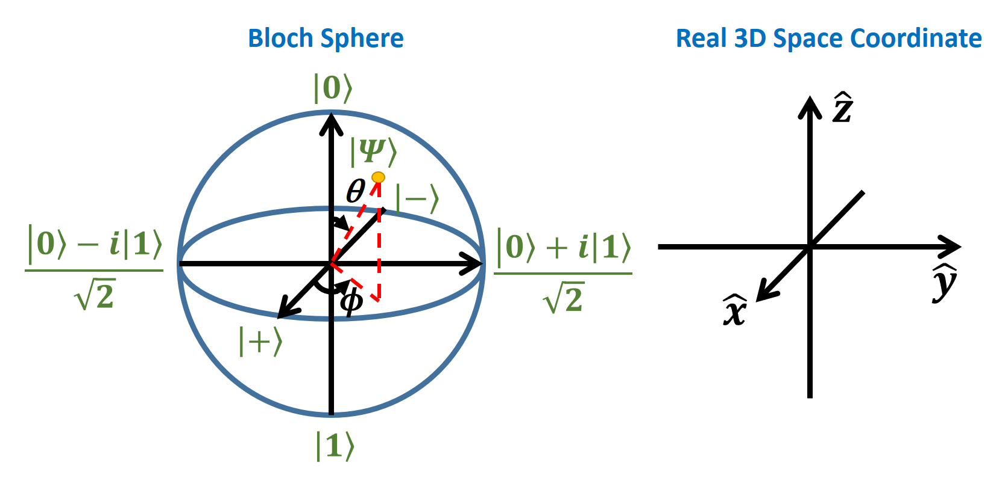
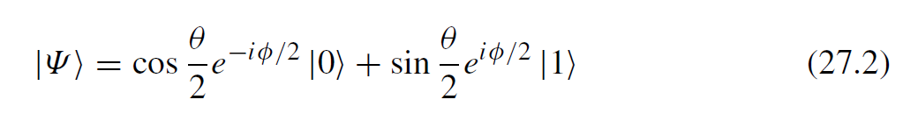
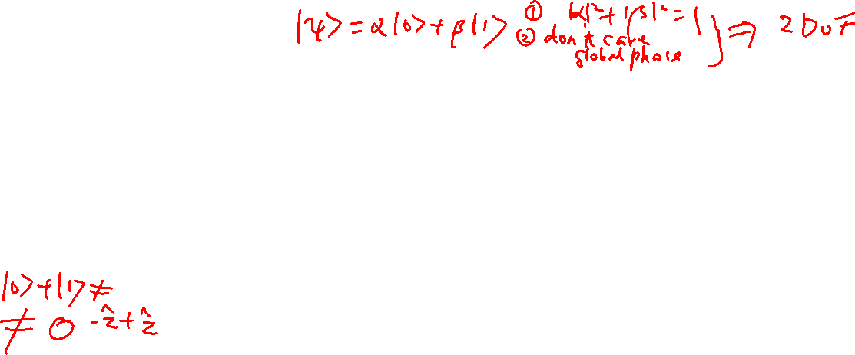
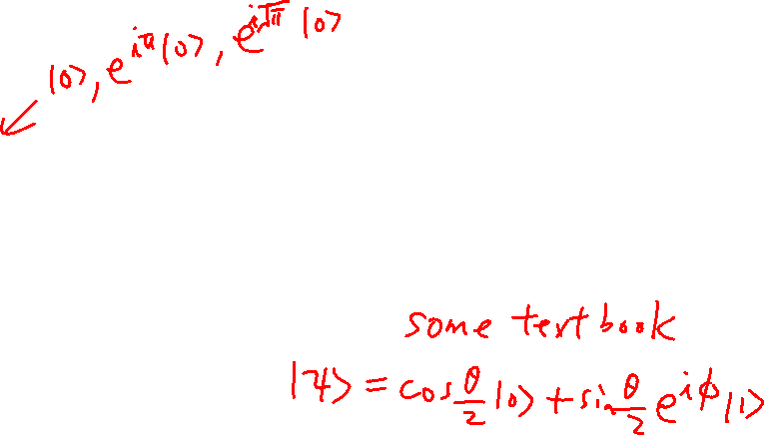
Embedding C² space in 3D space
From the last lecture
Learning outcomes: Bloch sphere is the embedding of the 2D complex space in a real 3D space. The global phase is ignored.
Each point represents an infinite number of states that differ by a global phase.

Slide 5

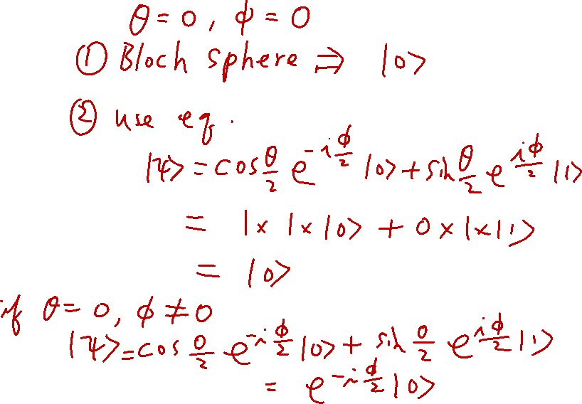
Extrema in Bloch Sphere
From the last lecture
Learning outcomes: Able to perform substitutions

Slide 6
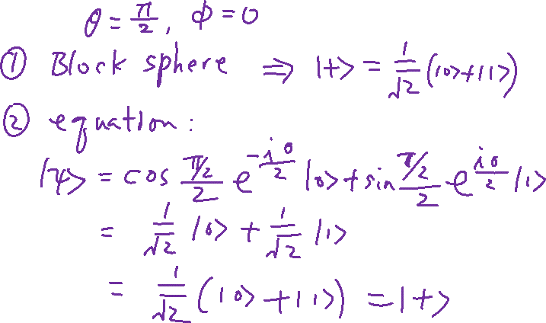
Extrema in Bloch Sphere
Learning outcomes: Able to perform substitutions

Slide 7
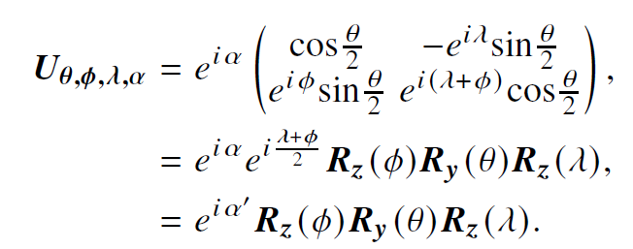
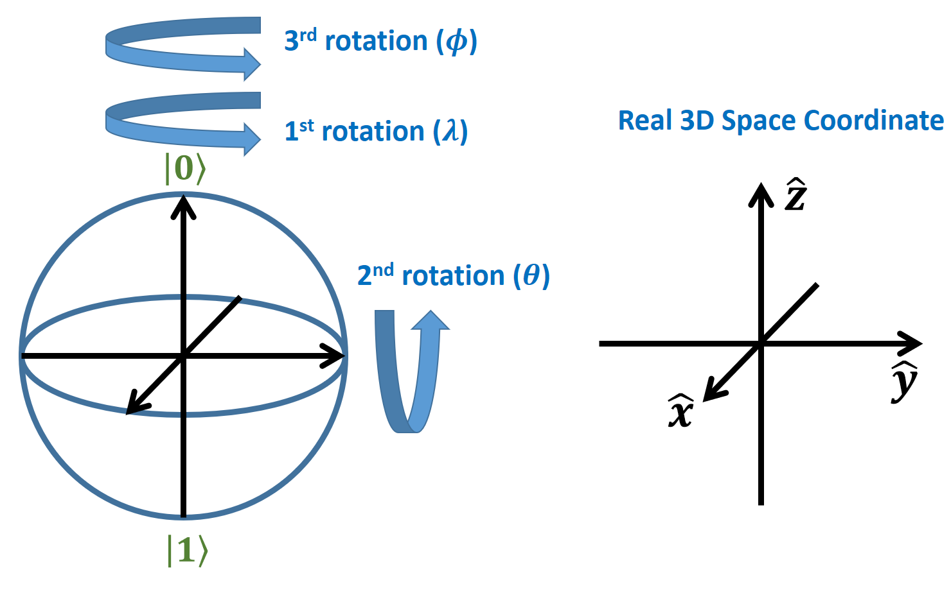
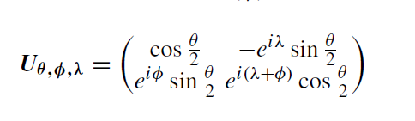
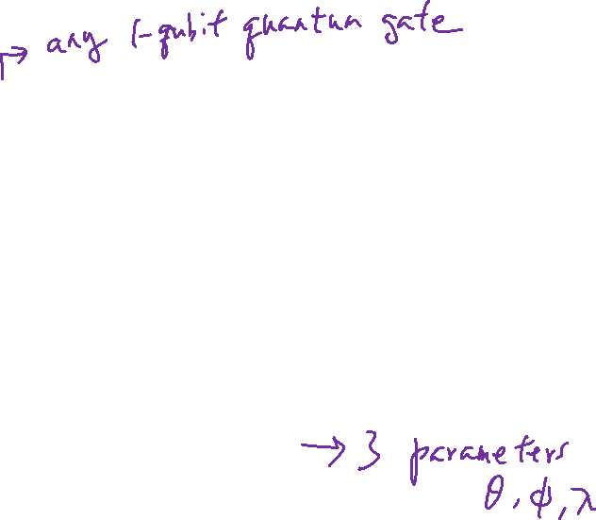
Rotation on Bloch Sphere
Learning outcomes: Mapping of vector rotation to real 3D space Euler rotation
Any Rotation on the Bloch Sphere
Ignoring the global phase

Slide 8
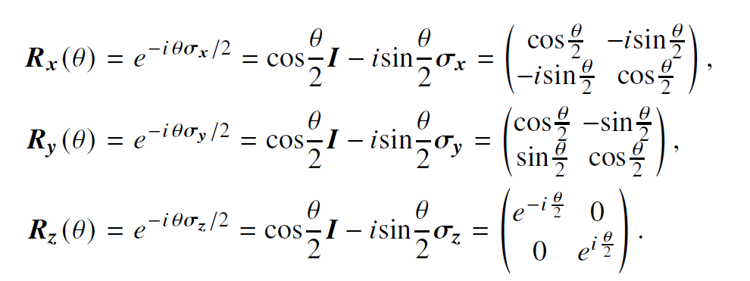
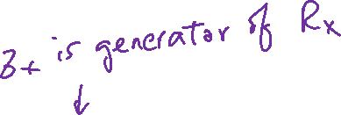
Pauli Matrices are the Generators of the Rotations

Slide 9
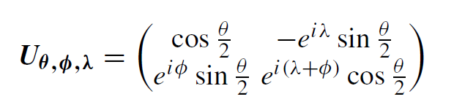
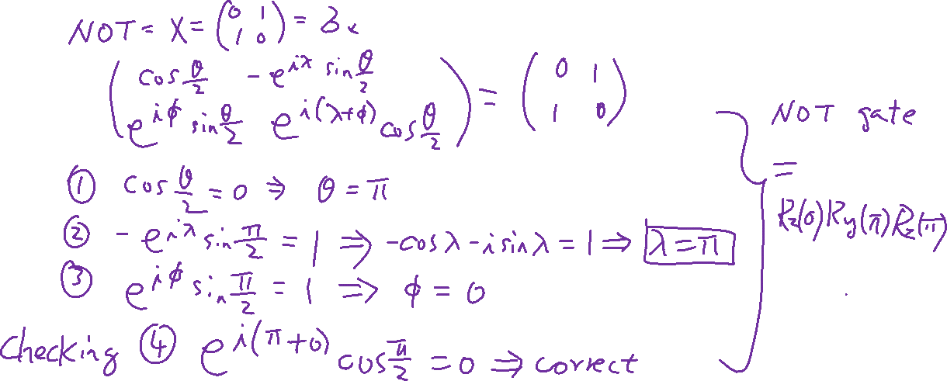
Construct a NOT Gate
Learning outcomes: Visualize quantum gate in action

Slide 10
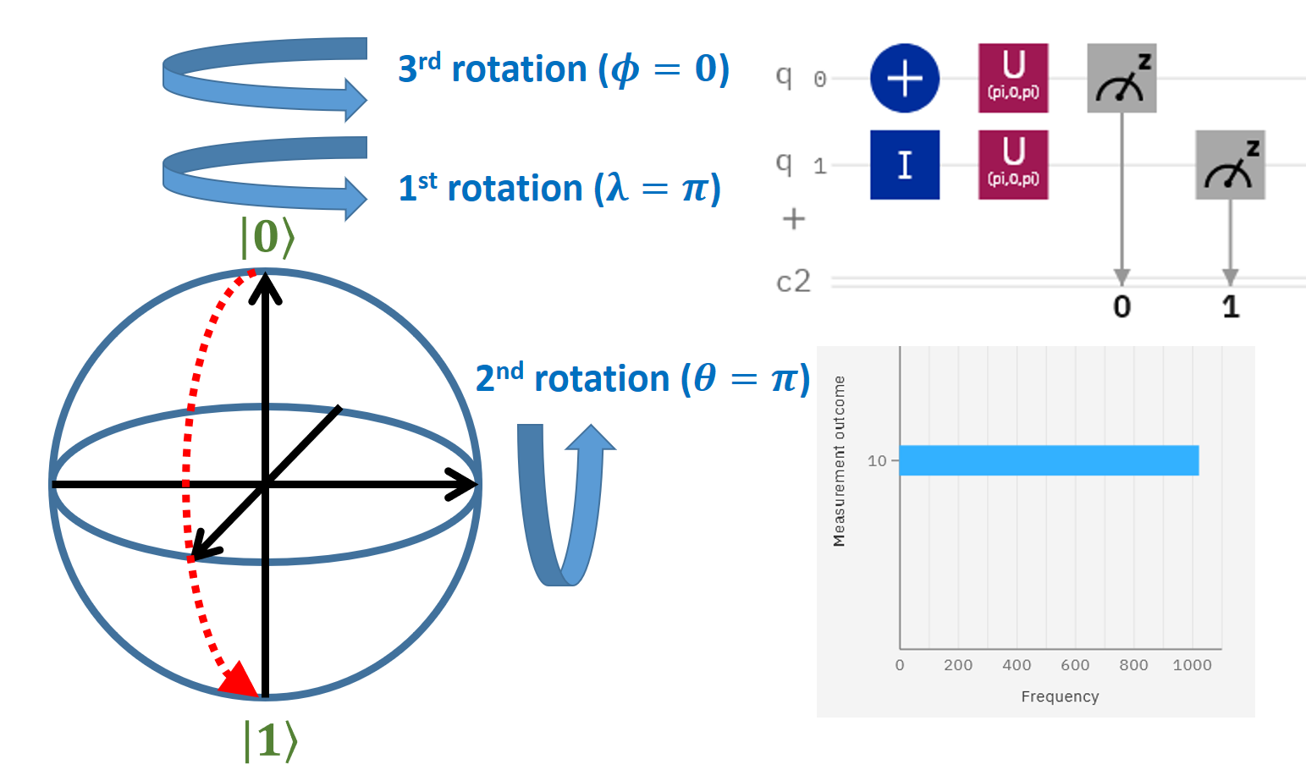

Slide 11
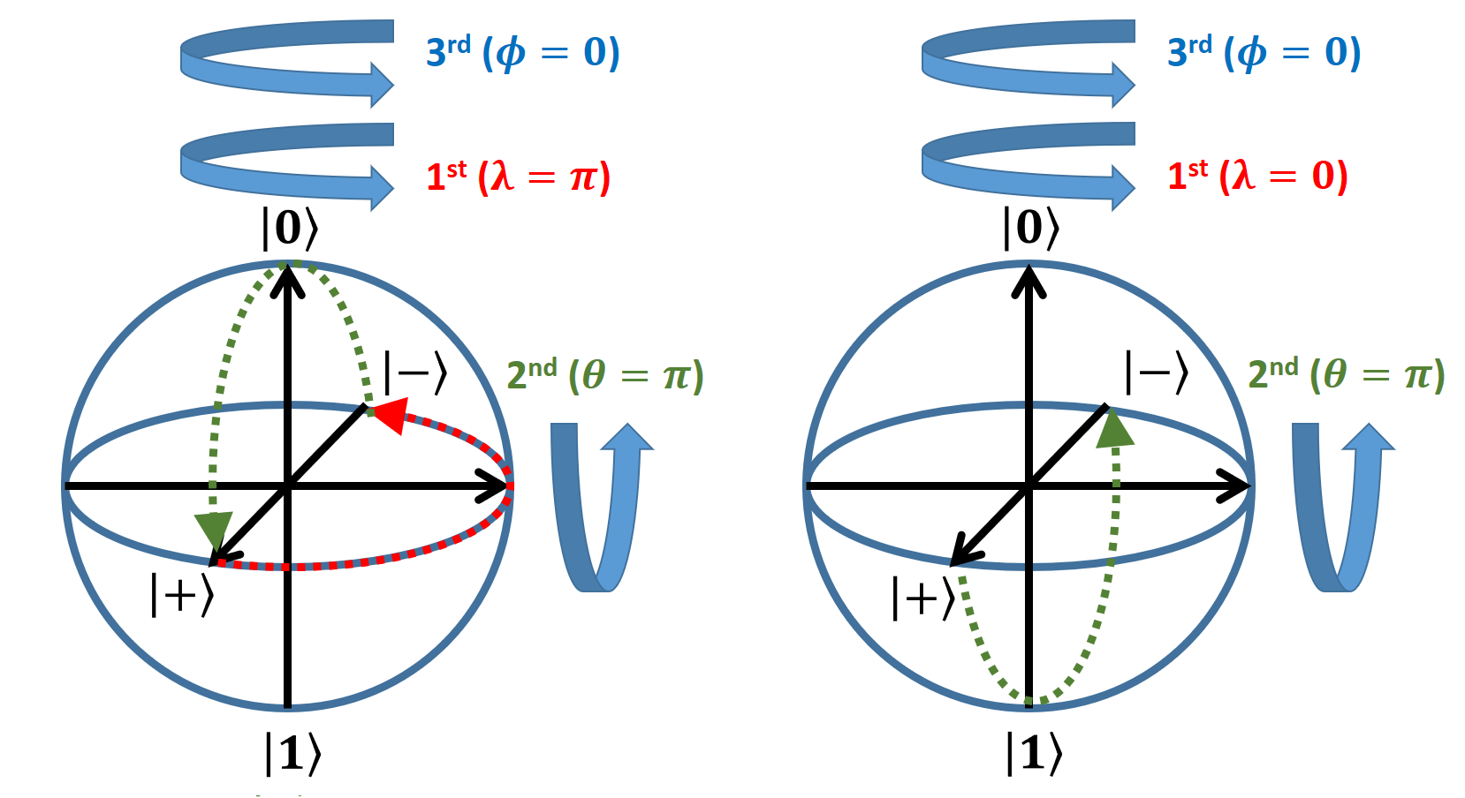
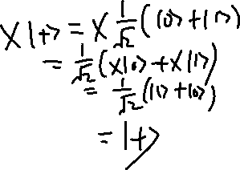
Wrong method to construct rotation matrix Do not use visualization on Bloch’s Sphere to construct rotation matrix
Learning outcomes: Pitfall of using the Bloch Sphere
Correct X gate
Incorrect X gate

Slide 12
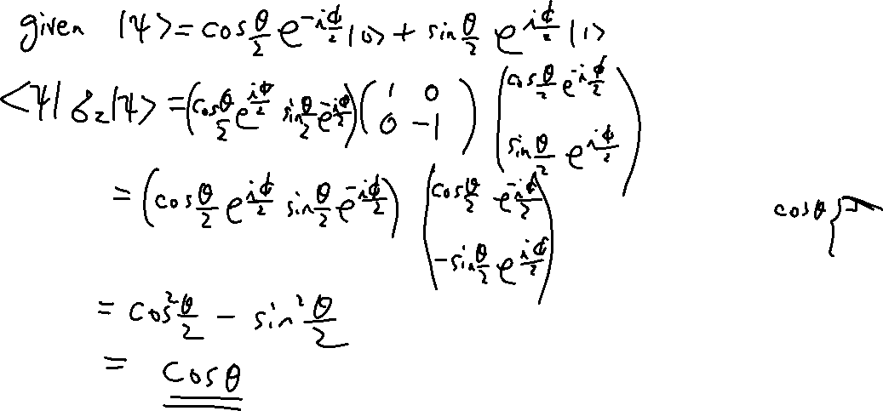
Expectation Values for Pauli Matrices
Learning outcomes: Expectation value is just the projection of the state on the directional vector of the matrix.

Slide 13
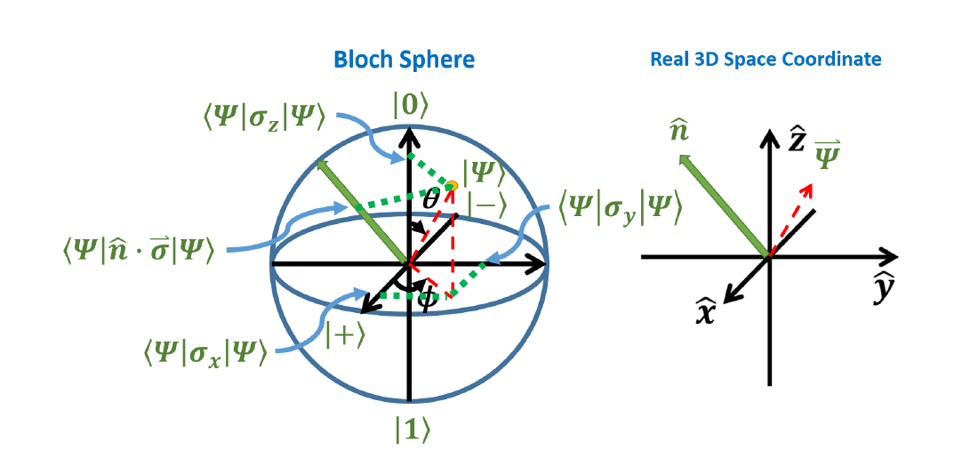
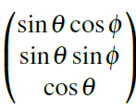
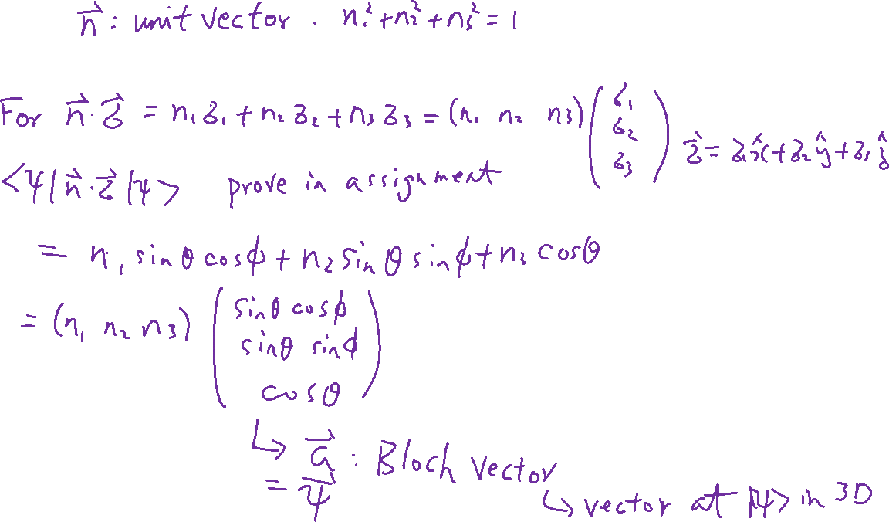
Expectation Values for Pauli Vector
Learning outcomes: Expectation value is just the projection of the state on the directional vector of the matrix.

Slide 14
Density Matrix on Bloch Sphere
Chapter 6 of “Quantum Computing Architecture and Hardware for Engineers: Step by Step”
Introduction to Quantum Computing From a Layperson to a Programmer in 30 Steps – YouTube
https://www.youtube.com/playlist?list=PLnK6MrIqGXsJfcBdppW3CKJ858zR8P4eP

Slide 15
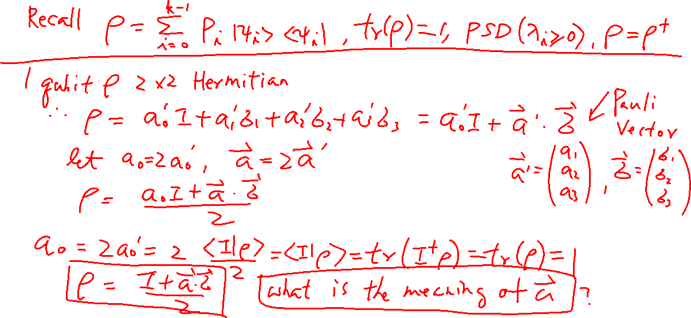
Density Matrix of a Qubit
Learning outcomes: Properties of the density matrix of qubit

Slide 16
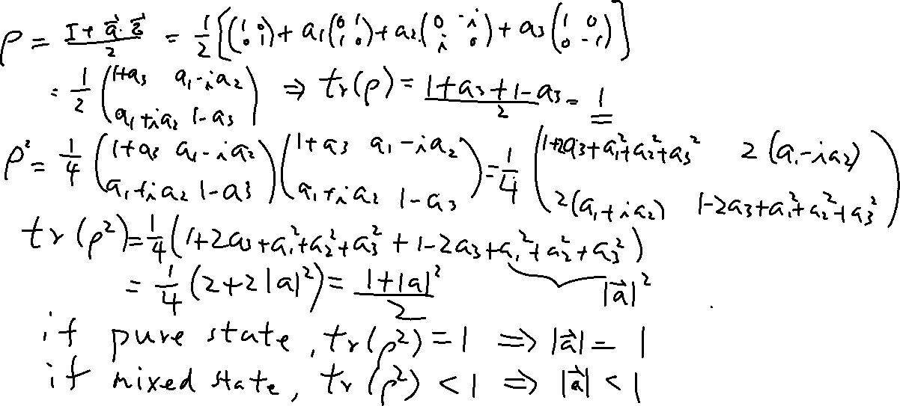
Density Matrix of a Qubit
Learning outcomes: Properties of the density matrix of qubit

Slide 17
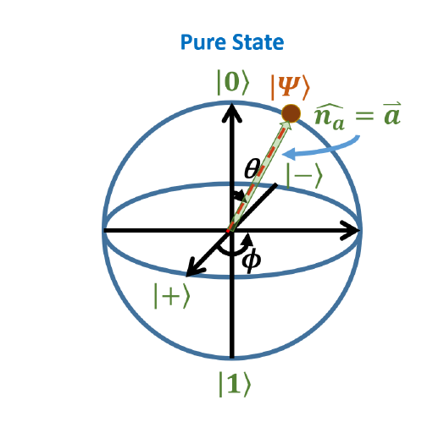
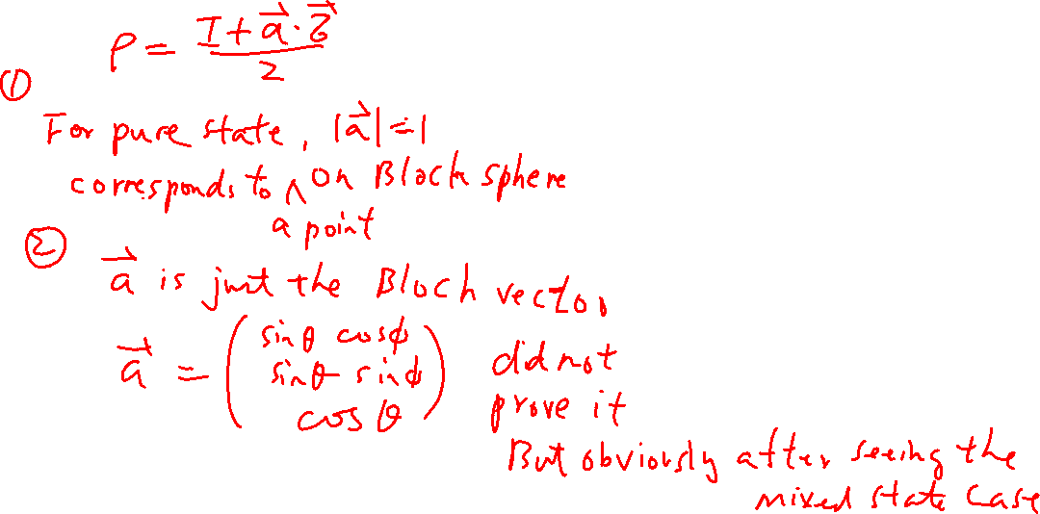
Pure State on Bloch Sphere
Learning outcomes: Understand how to map a pure state to the Bloch sphere

